Slide 1
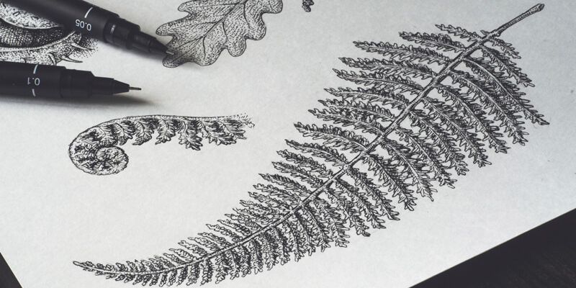

Nature Drawing Practice

Slide 2
Agenda
Warm-ups
Gestures
Seeing shapes
Proportions

Slide 3
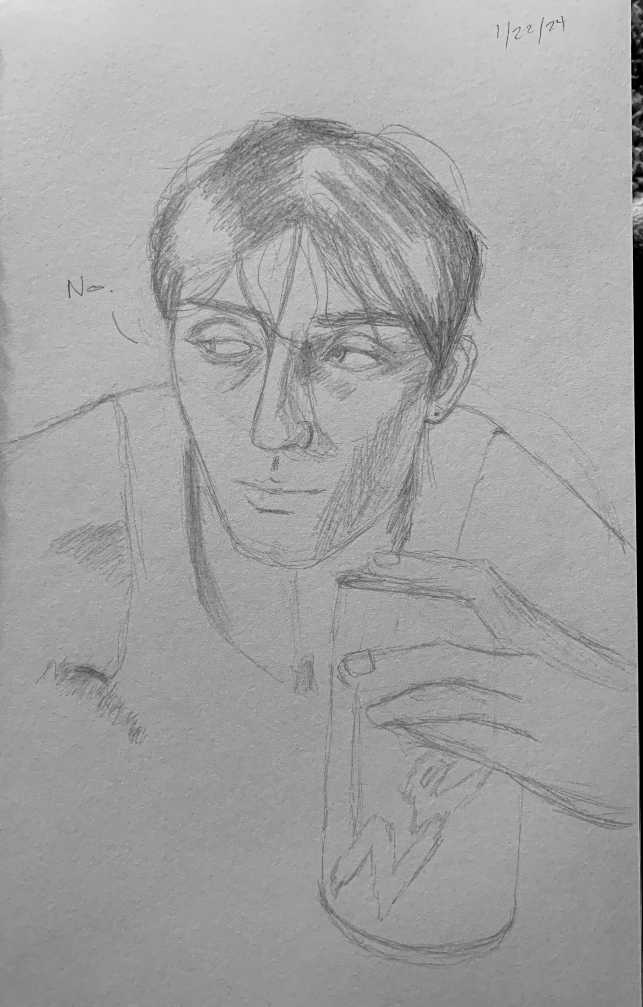
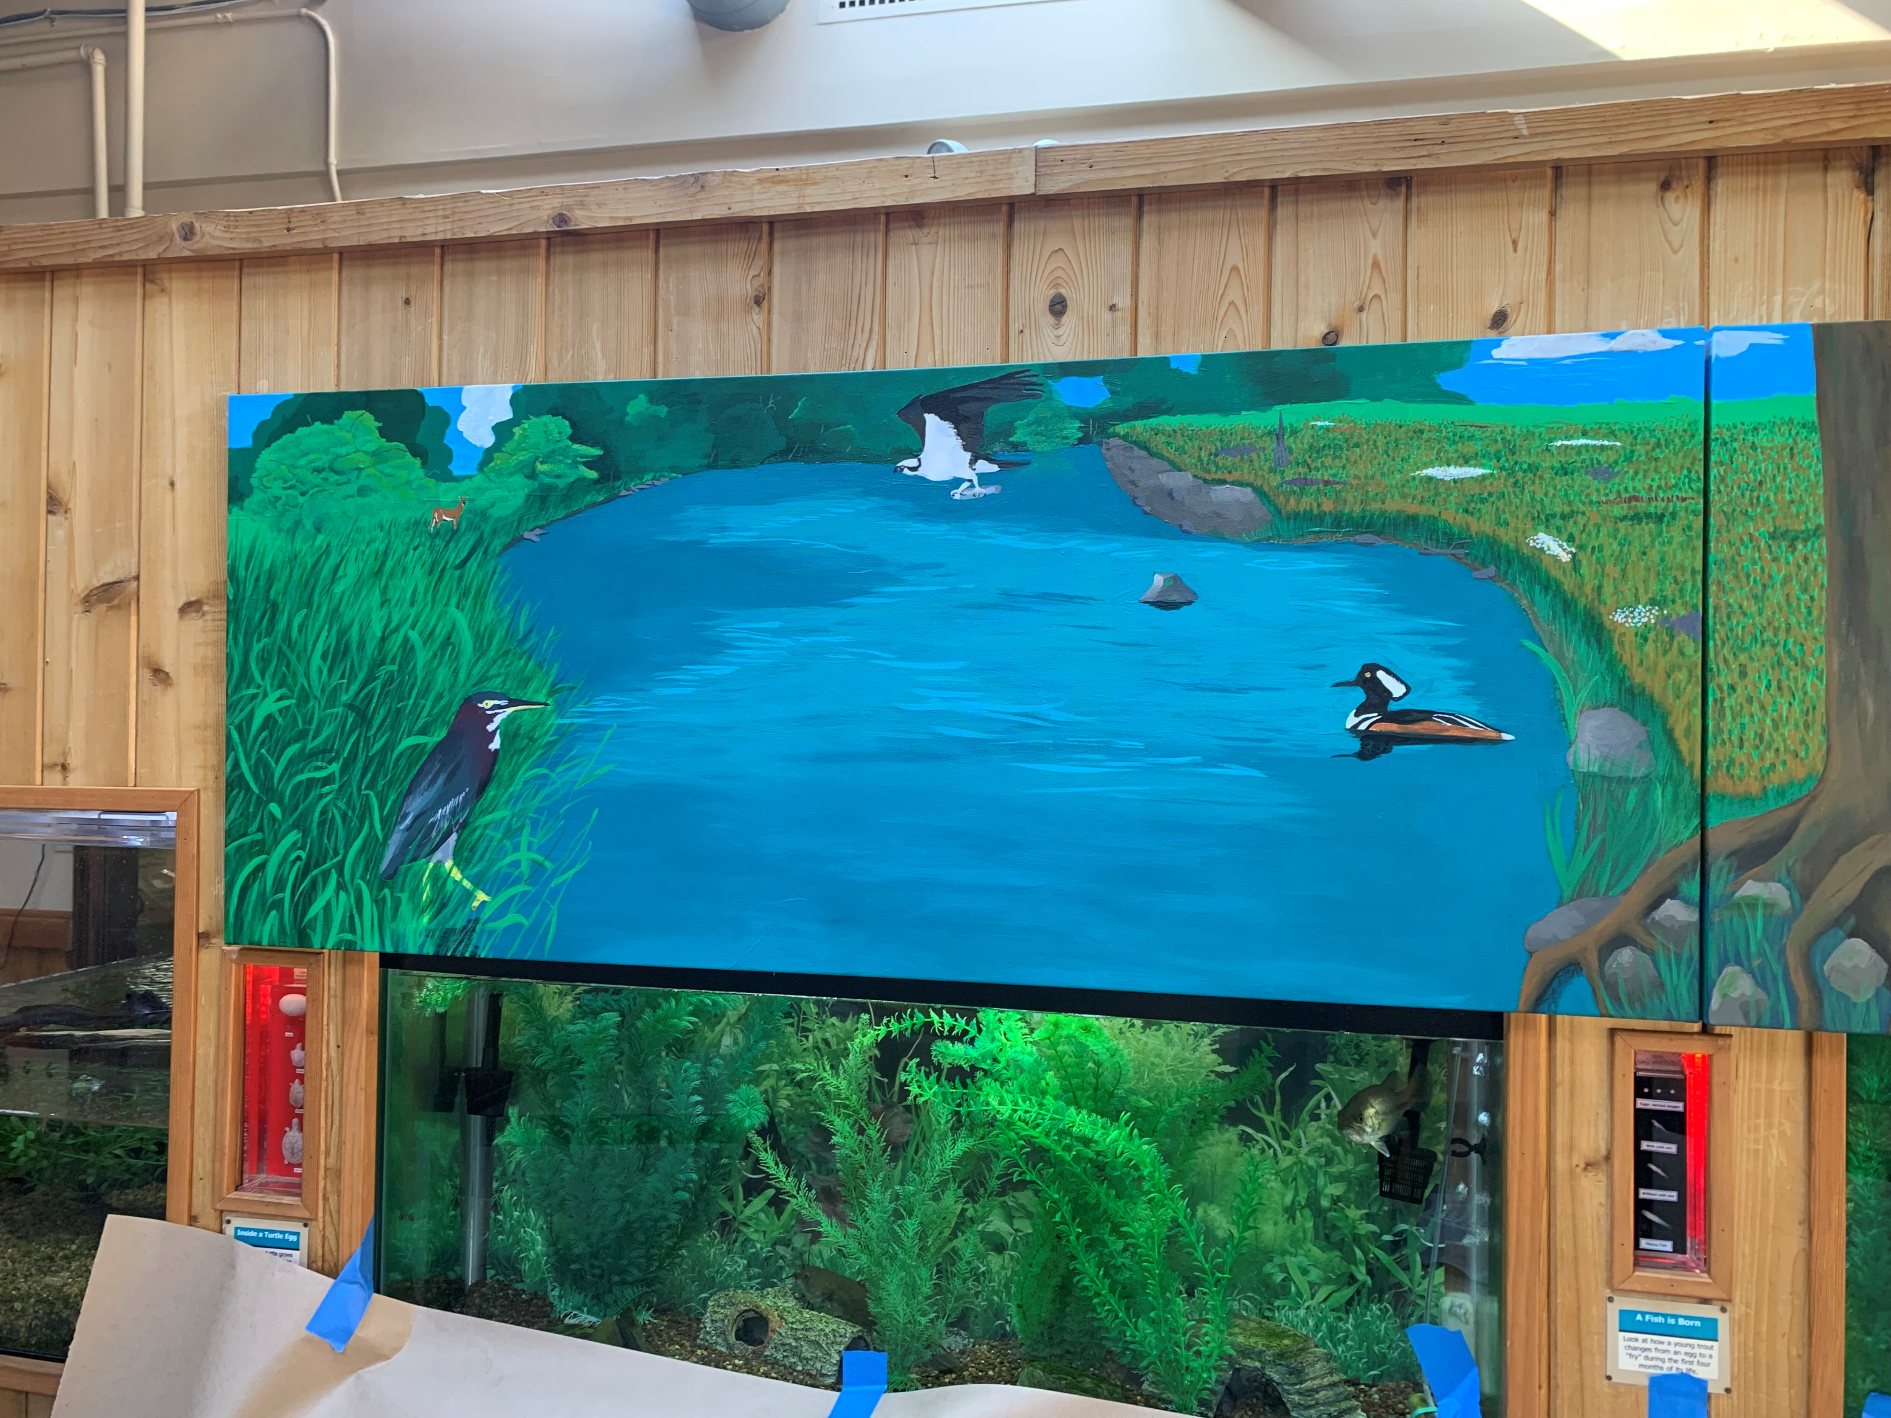
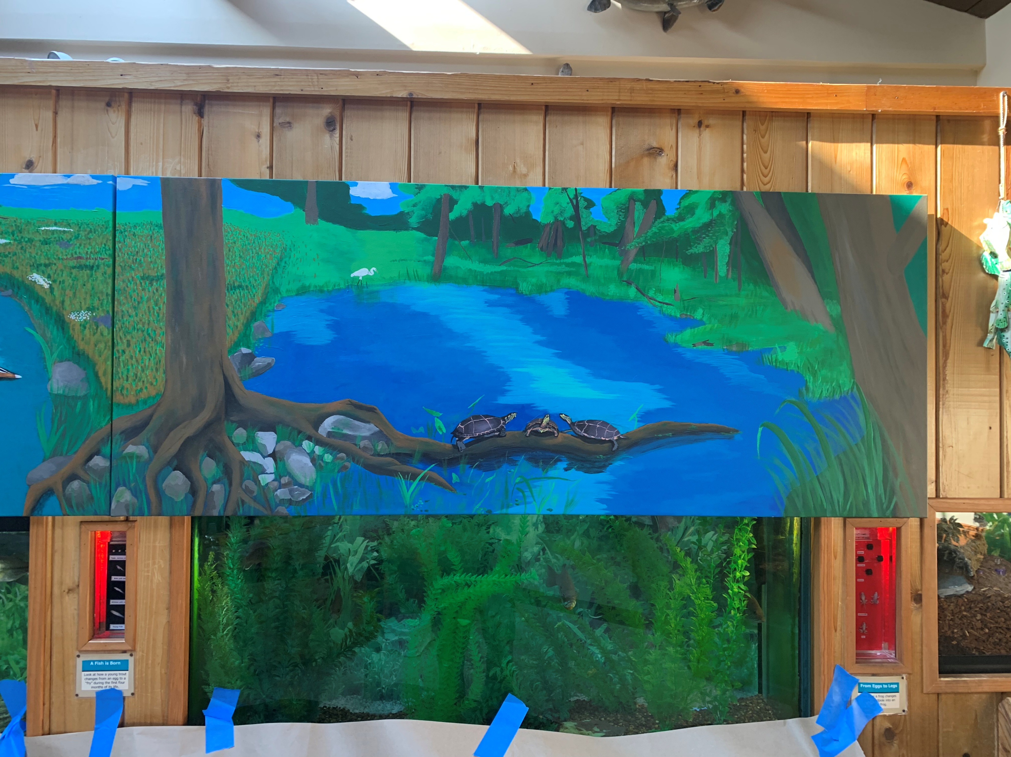
About me
Amateur visual artist– practicing for about fifteen years
Mainly pencil drawing, acrylic mural painting, but also printing, weaving, inking, anything that really excites me.

Slide 4
Reminders
Be gentle with yourself
Keep your hand as relaxed as you can– use your arm/shoulder instead of your wrist for drawing
Stay comfortable
We are NOT making beautiful end products– this is practice!
My drawing style leans towards realism, and I like to draw people and animals. But all the same still applies!

Slide 5
Materials
Everyone should have
  1 drawing clipboard loaded with paper
  3 drawing pencils
  1 eraser
  1 pencil sharpener
  Charcoal at table

Slide 6
Exercise 1- Warm ups
Warm ups are important for the arm, hand, and wrist muscles. Also, they help switch your brain into drawing mode.
Our warm up is going to be easy and relaxed.
Fill your paper with shapes! Big circles, small triangles, lines of various length and thickness. Try out your different materials, try out small sketches if your feeling bold. We want very little white space left over on your sheet.

Slide 7
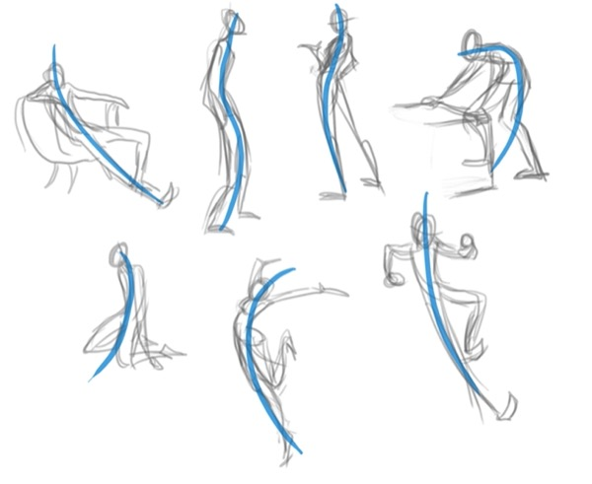
Gestural Sketches
Gestures are quick sketches that give you the overall idea of what an object looks like and moves like, without any details. Often used for sketching human forms.
This is a form of an underdrawing– a sketch that will help you fin the bones of your drawing before you get into the details
We start these by finding our line of action, then placing pieces on it.

Slide 8
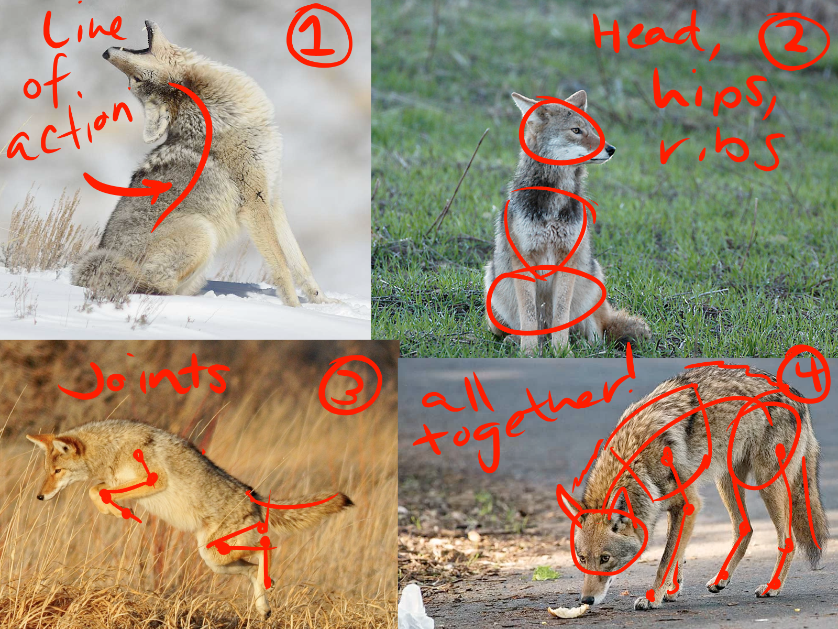

Slide 9
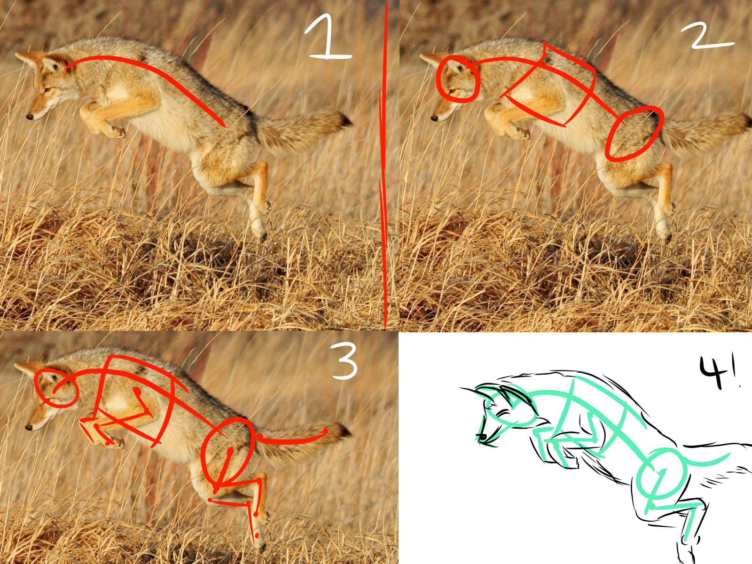

Slide 10
Exercise 2- Gesture Sketches
The following images will be up on the screen for 10 seconds. Find JUST the line of action– what does the spine of the animal look like? Which way does the plant bend? Find the center line and that alone. Ready?

Slide 11
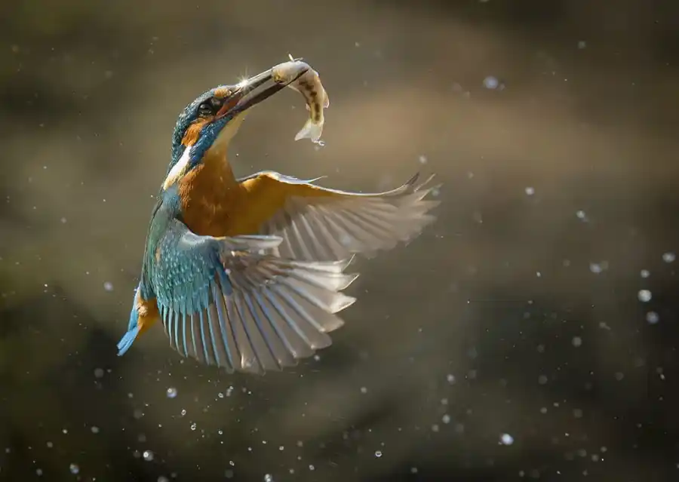

Slide 12
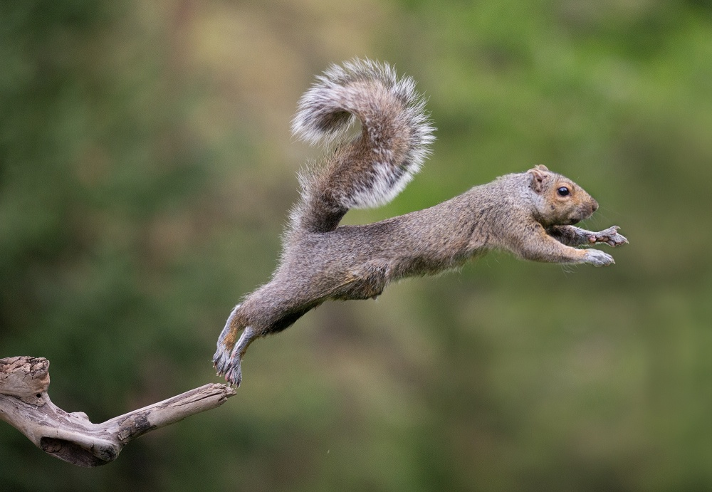

Slide 13
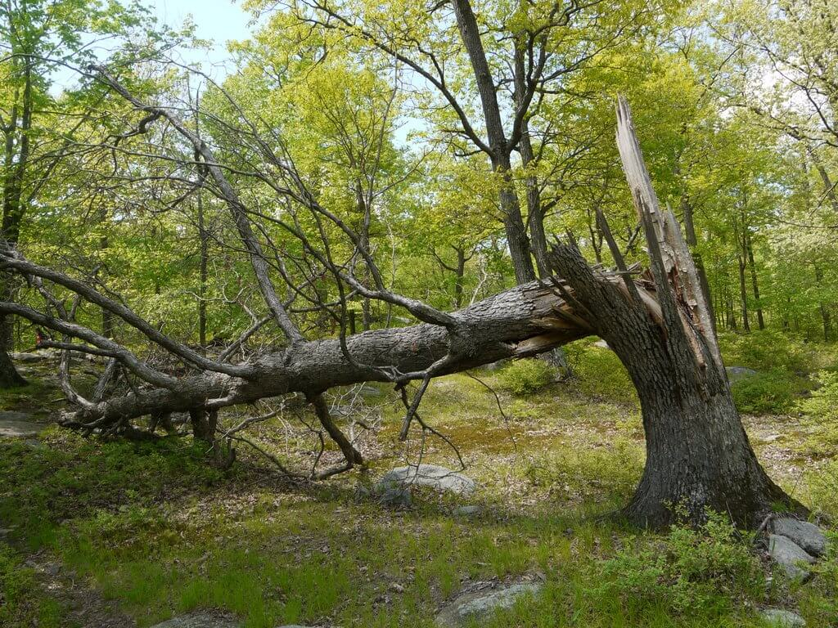

Slide 14
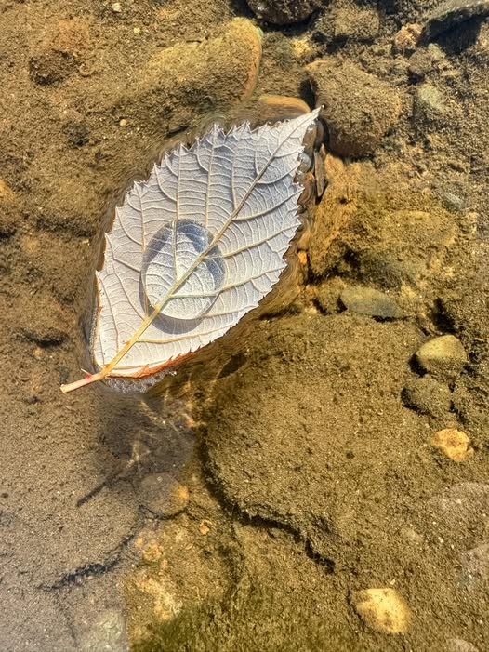

Slide 15


Slide 16
Seeing the shape
All things are made up of shapes.
As artists, we can break things down into their smaller shapes to give us a “base” or skeleton to build off.
This also helps us figure out our proportions before we commit to the whole drawing

Slide 17
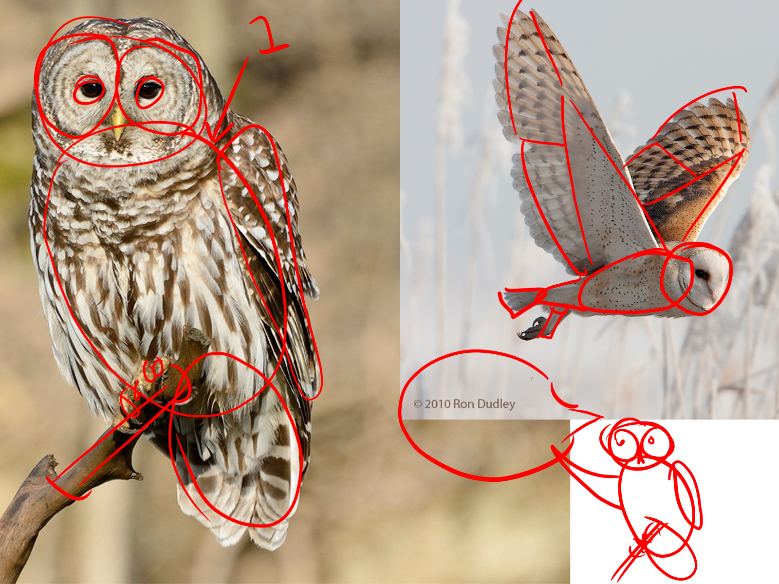
Most shapes in nature are round/organic!

Slide 18
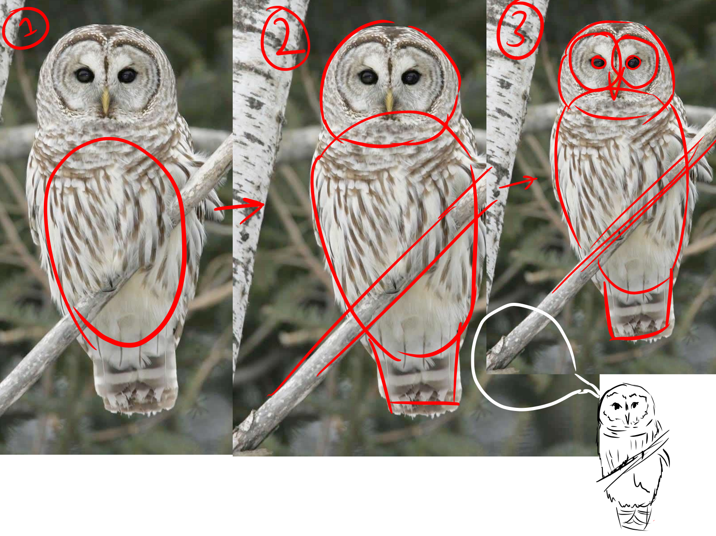
Always start with the main chunk of the body!

Slide 19
Exercise 3- Finding the shape
Pick a few reference images from around you, or pick one of the models.
Work on identifying the shapes in all the pictures and drawing them. Don’t worry about making something that looks good.
Make sure to start with your line of action!
Having a hard time? Try flipping you image upside down.

Slide 20
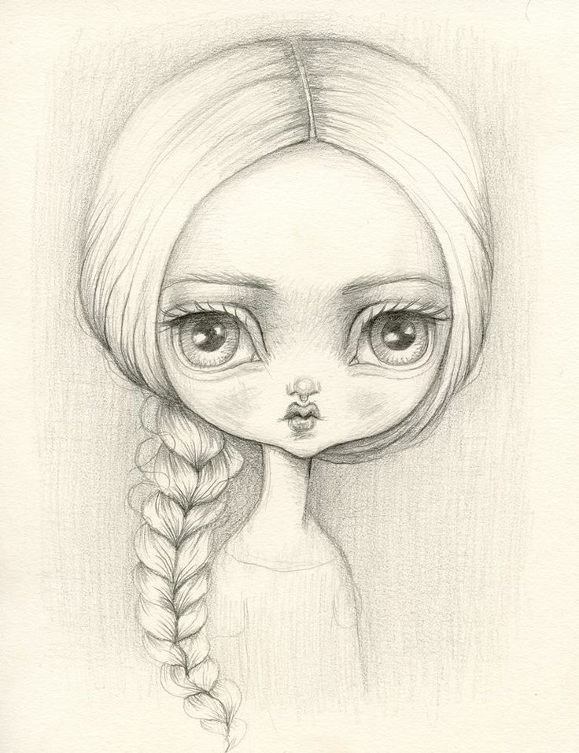
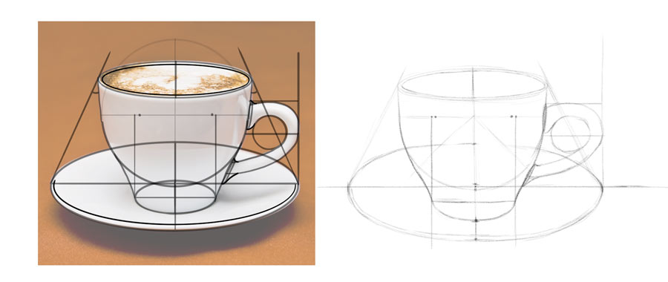
Proportional Poses
Proportions refer to the size things are in relation to each other
Getting proportions right is important in depicting subjects realistically

Slide 21
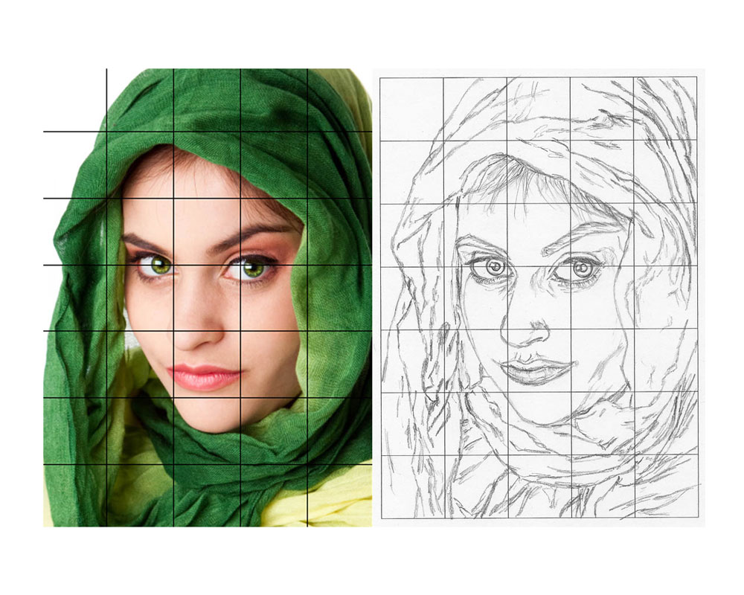
Grids help the eye
Having a reference grid can help you keep track of your proportions.
You can see how the lines of your subject interact with the lines of the grid and use this to keep your drawing “on track”.

Slide 22
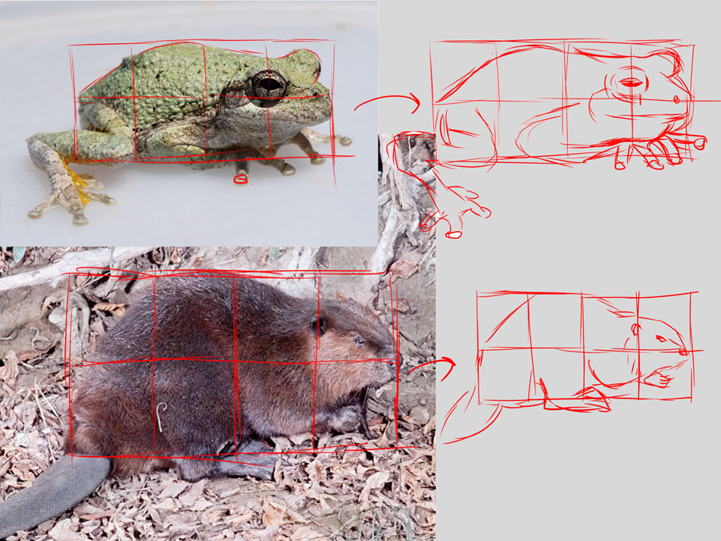
Exercise 3- Gridding
Pick a reference image and draw a grid that encompasses most of the subject– then replicate that grid on your paper.
Use this grid to help you reference the proportions of your drawing– look at each square as you fill it in. How do the lines of your subject intersect the lines of your grid?

Slide 23
Free Draw Time
The rest of the program is yours to practice your drawings, finish ones you started, etc. Try out the different materials at your table!

